Slide 1


Online Hospital Management System (OHMS)
Institute for Advanced Computing and Software Development (PG-DAC)
By :-
ABHINAV SINGH- 210941220006
SANDEEP MOPARE- 210941220106
(Group No.71)
Guide: Mr. Milind Arjun
Mrs. Sonali Nikam

Slide 2
Objective
Define hospital
Recording information about the Patients that come.
Recording information related to diagnosis given to Patients.
Keeping record of the Immunization provided to children/patients.
Appointment booking with doctor.

Slide 3
Scope of the Project
Providing ease to user and hospital team.
Availability status of doctors and number of beds available in hospital will be managed
User will be able to book his appointment.
Application indirectly saves the time and money of user.

Slide 4
Modules:
Admin module
User module (patient)
Doctor module
Hospital module

Slide 5
Admin module
Has privilege to register hospitals.
Can update information about registered hospital and doctors.

Slide 6
Hospital Module
Can add/delete doctors
Can manage hospital’s profile
Can view doctors list
Can update availability of registered doctors
Can update bed counts.

Slide 7
User Module (Patient)
View availability status of doctors
View doctor list
View admit history. like bed count.
Book appointment
View prescription details
Manage own profile

Slide 8
Doctor Module
Manage patient. account opening and updating
Create, manage appointment with patient
Create prescription for patient
Provide medication for patients
Manage own profile

Slide 9
UML Diagrams

Slide 10
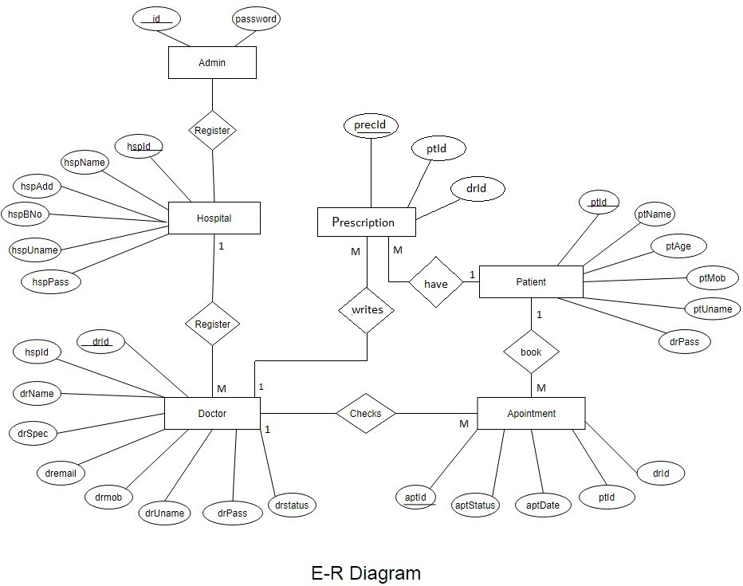

Slide 11
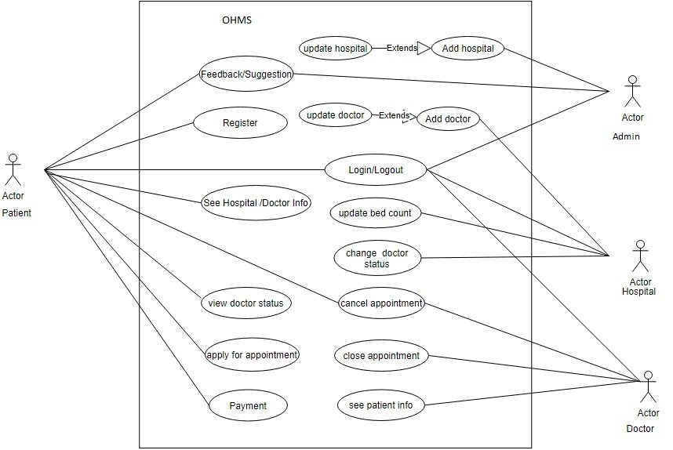
Use Case Diagram

Slide 12
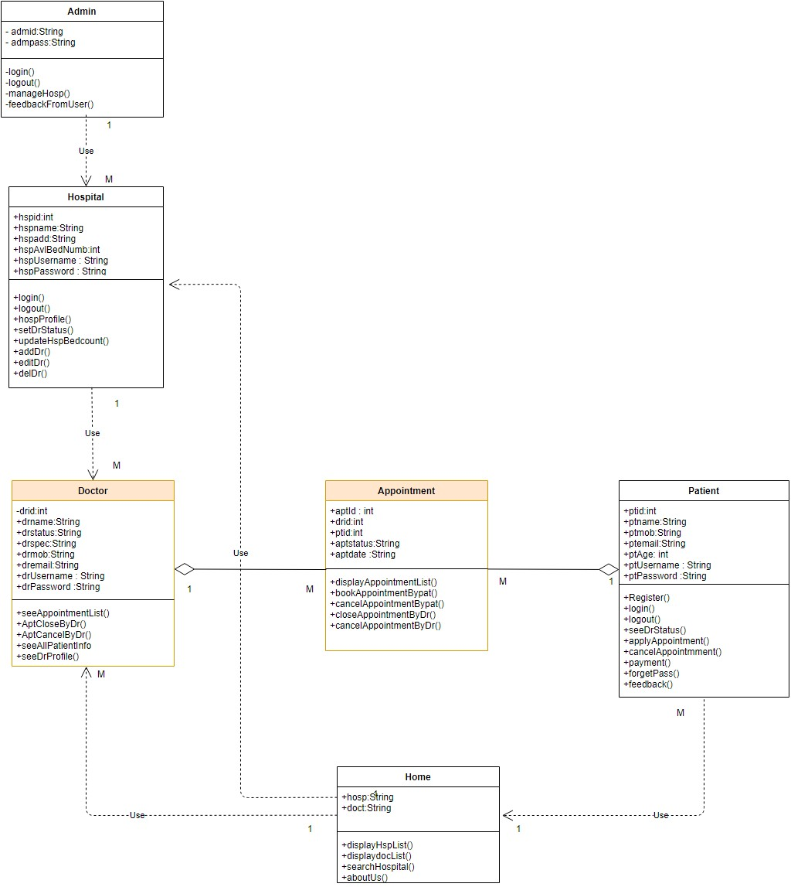
Class Diagram

Slide 13
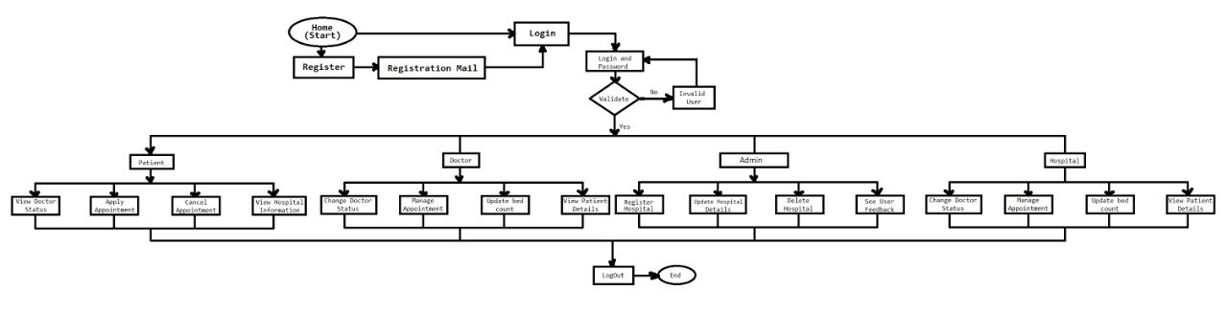
Page Navigation Diagram

Slide 14
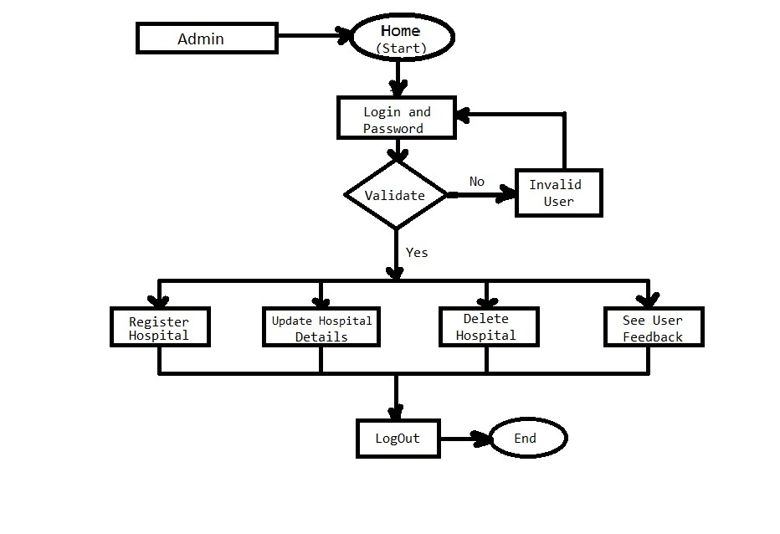
Page Navigation - Admin

Slide 15
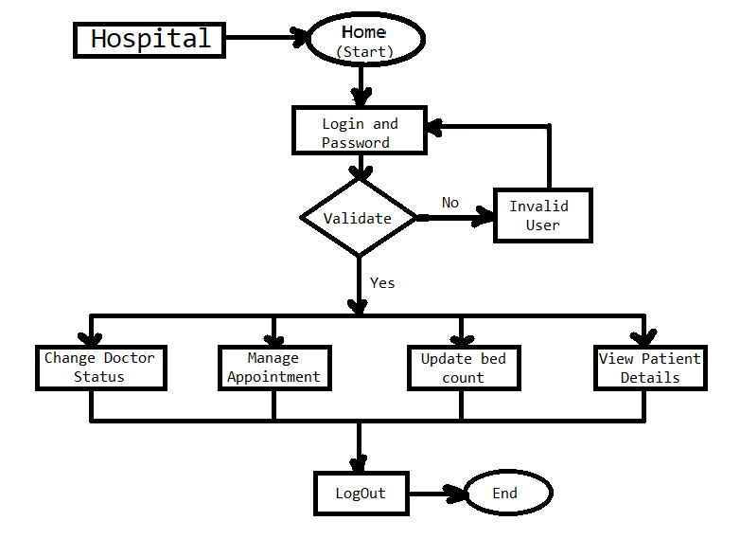
Page Navigation - Hospital

Slide 16
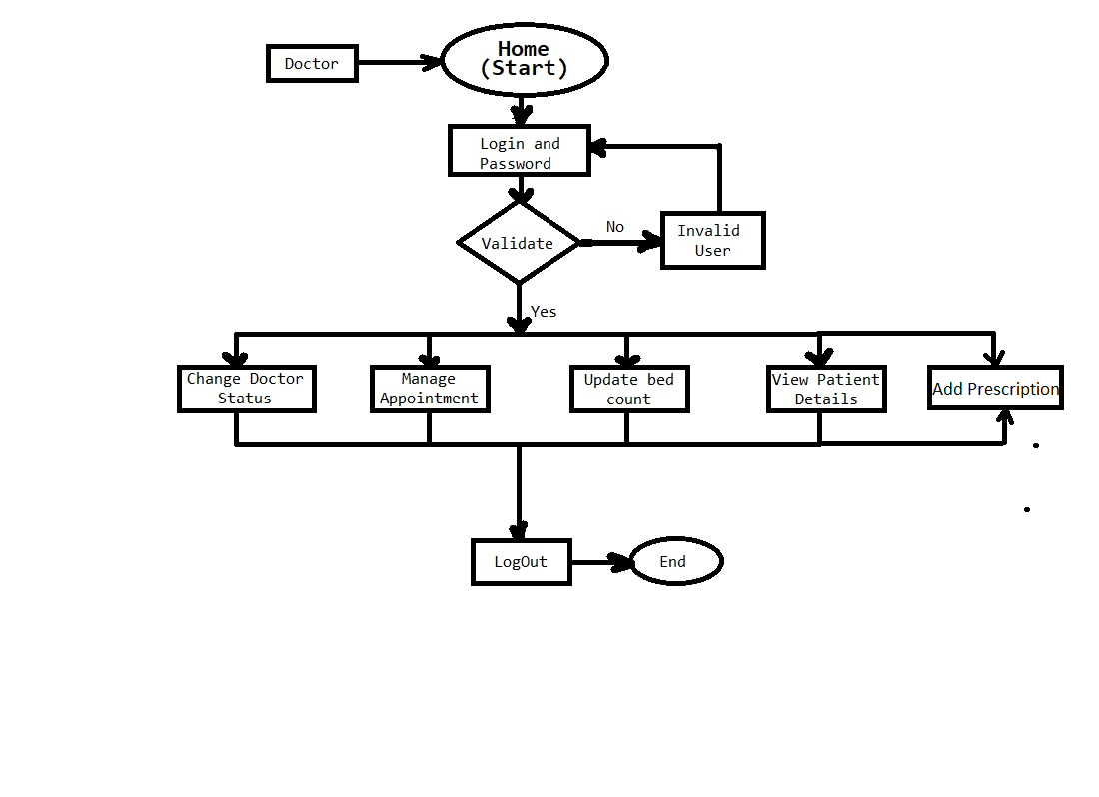
Page Navigation - Doctor

Slide 17
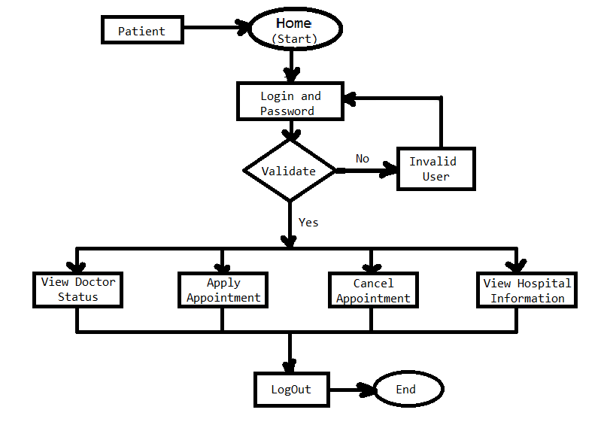
Page Navigation - Patient

Slide 18
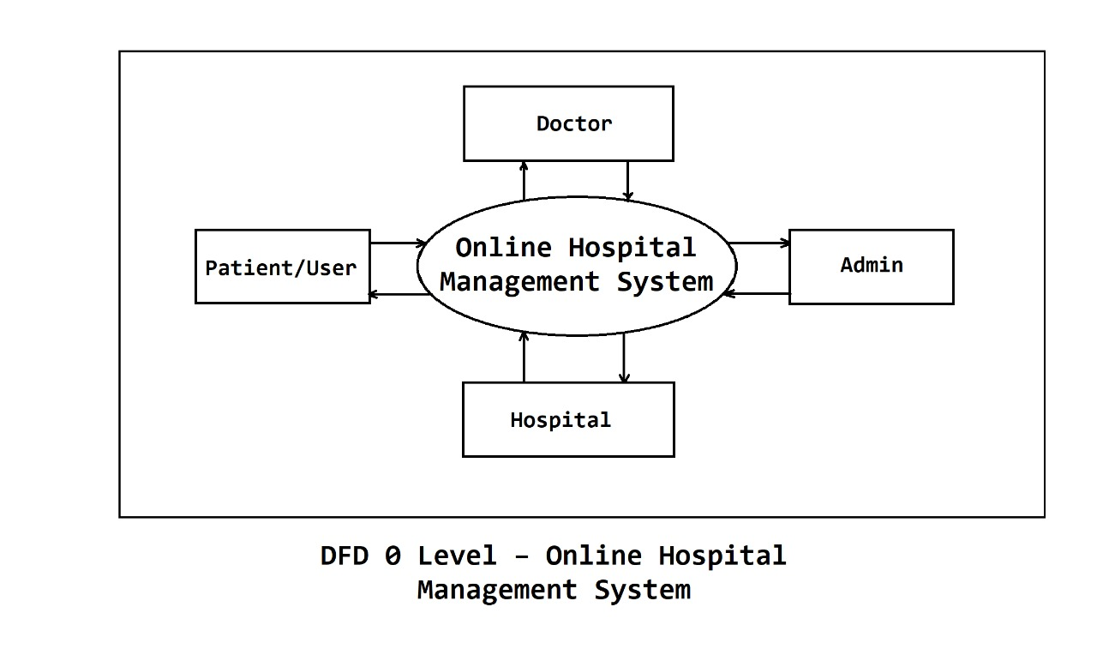

Slide 19
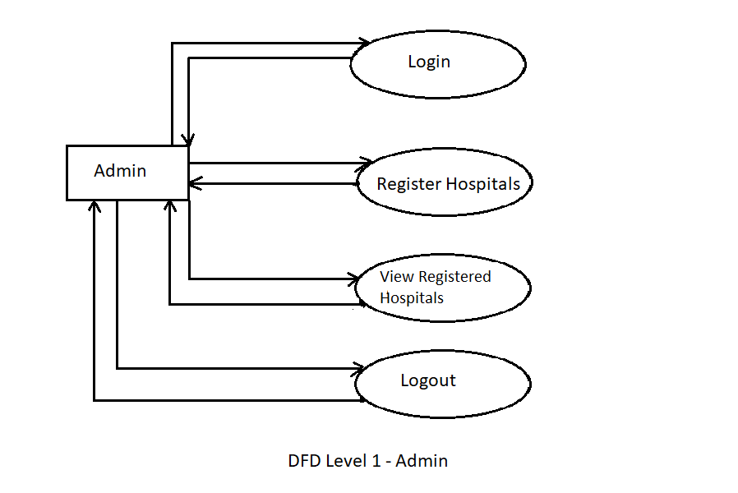

Slide 20
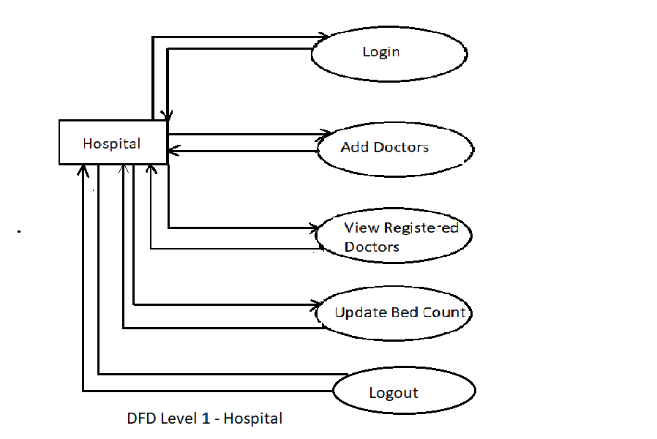

Slide 21
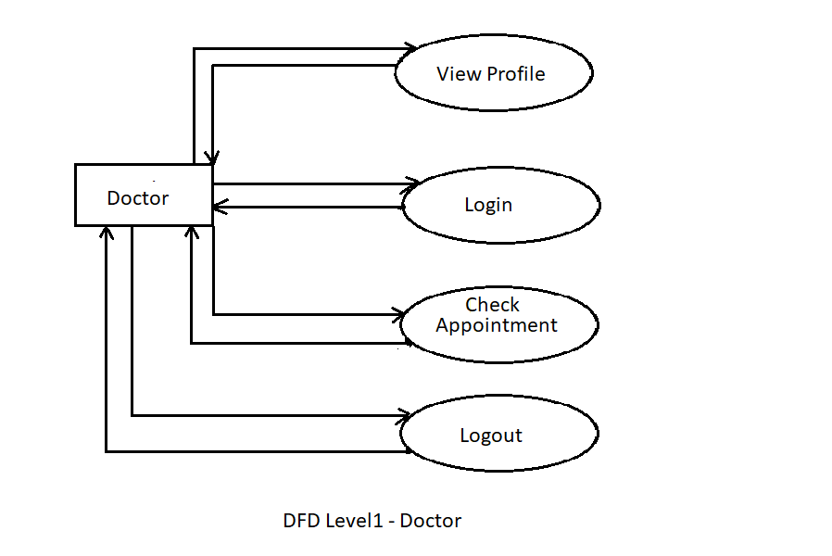

Slide 22
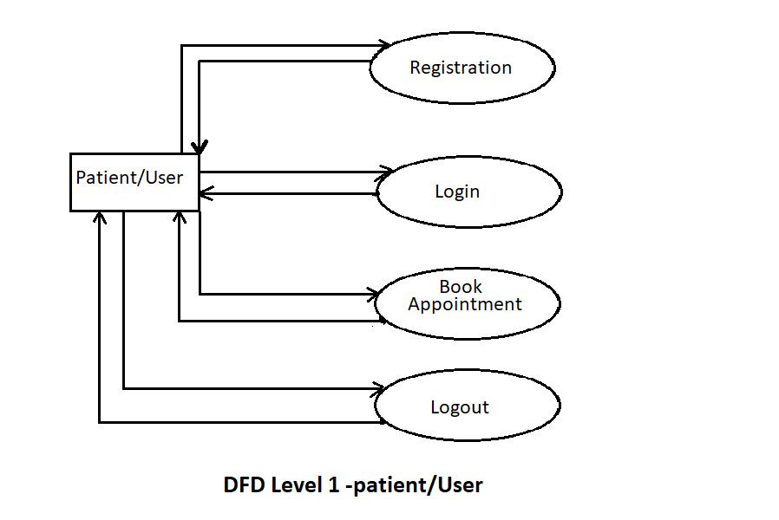

Slide 23
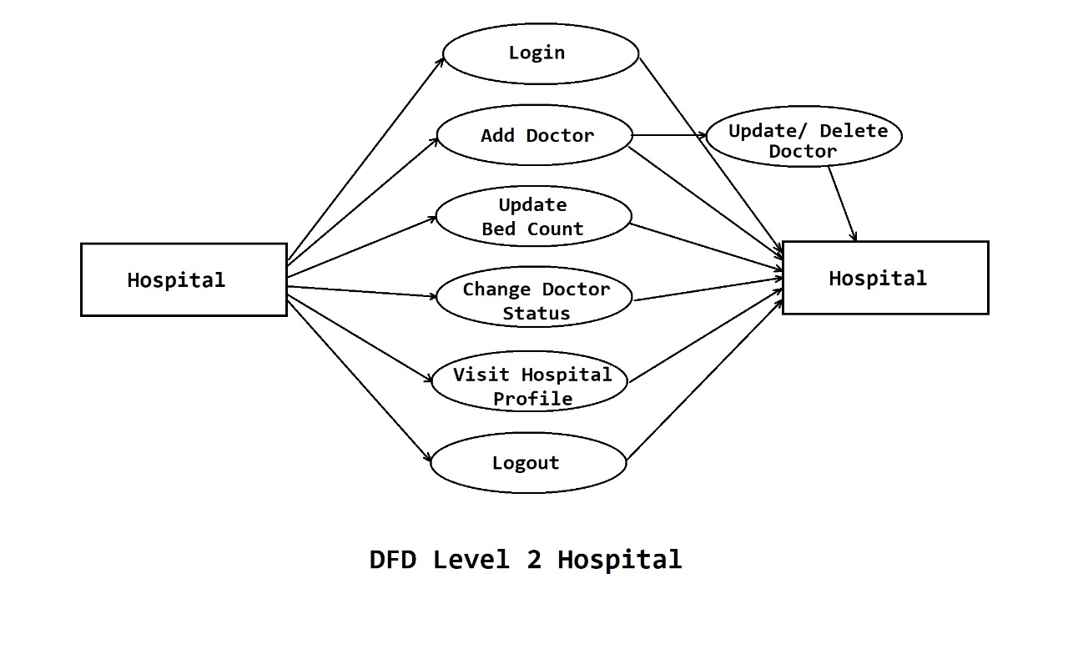

Slide 24
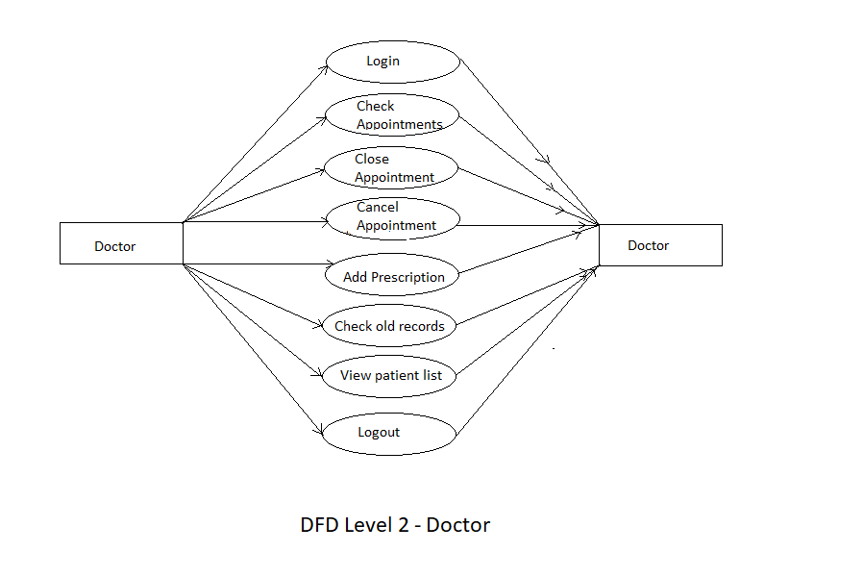

Slide 25
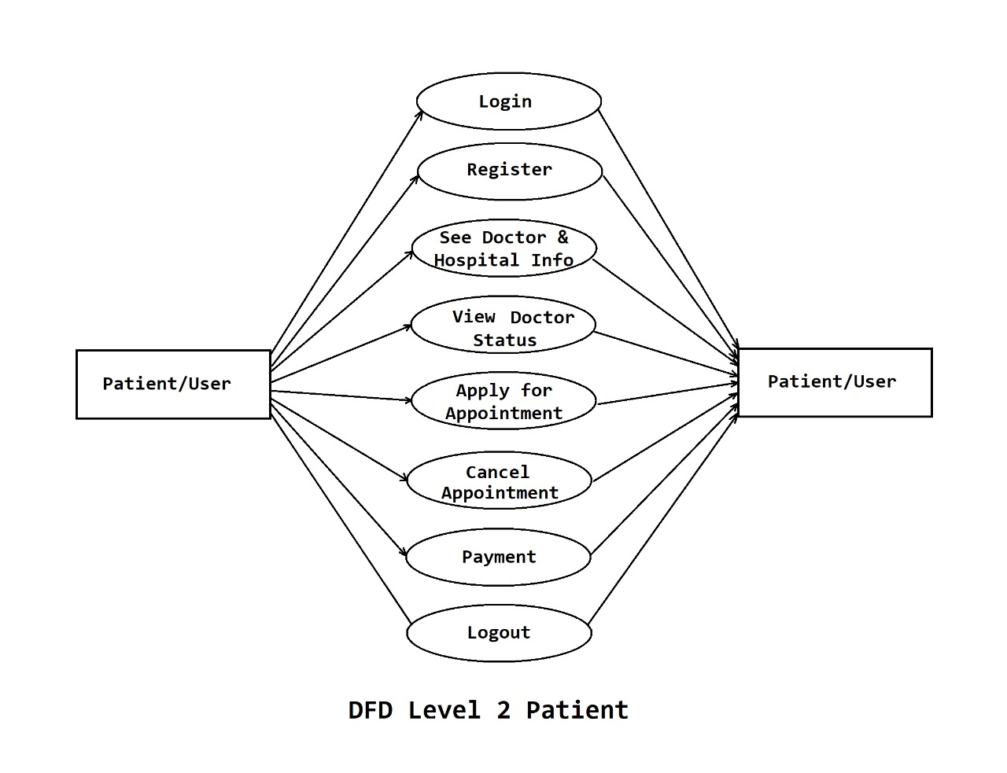

Slide 26
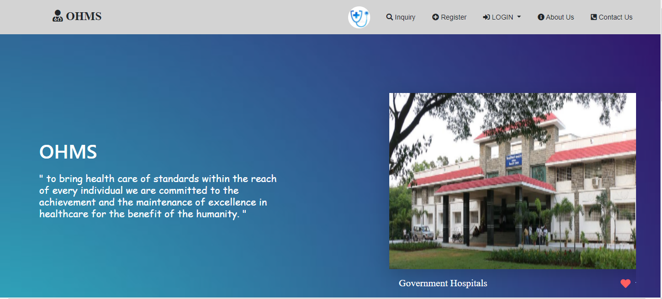
Home Page :-

Slide 27
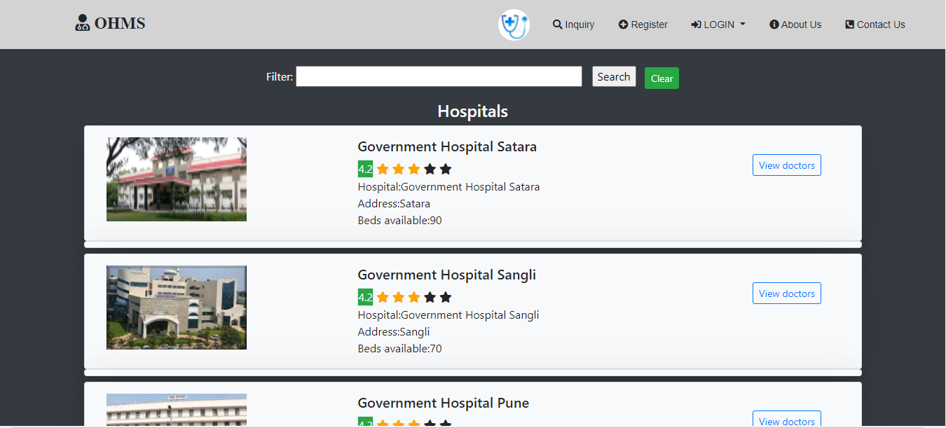
Inquiry: Search Hospital Filter

Slide 28
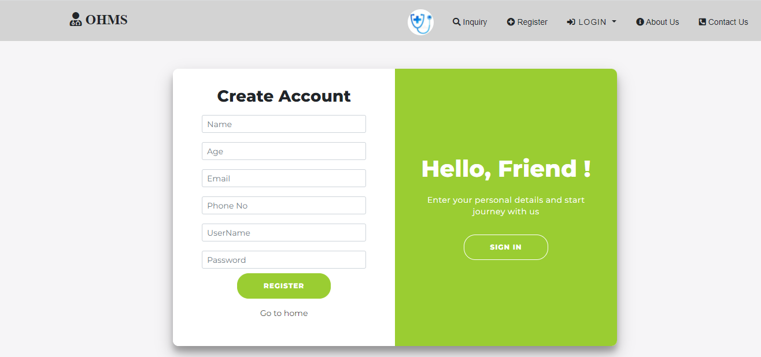
Patient Registration Page :-

Slide 29
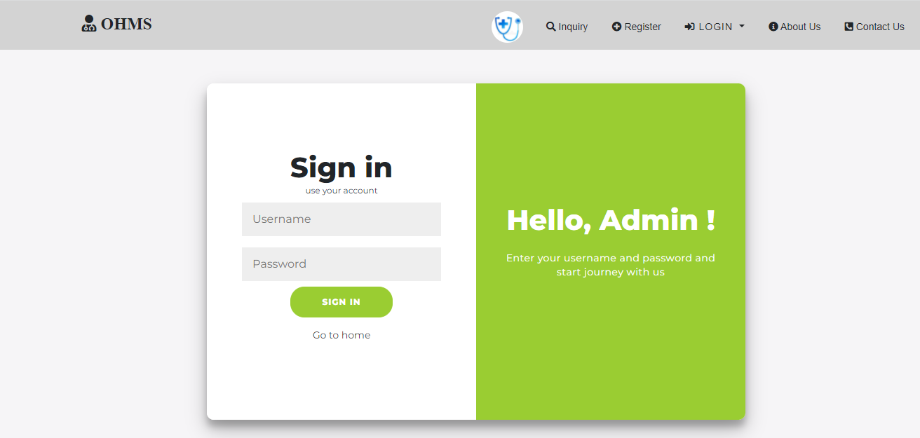
Admin Login Page :-

Slide 30
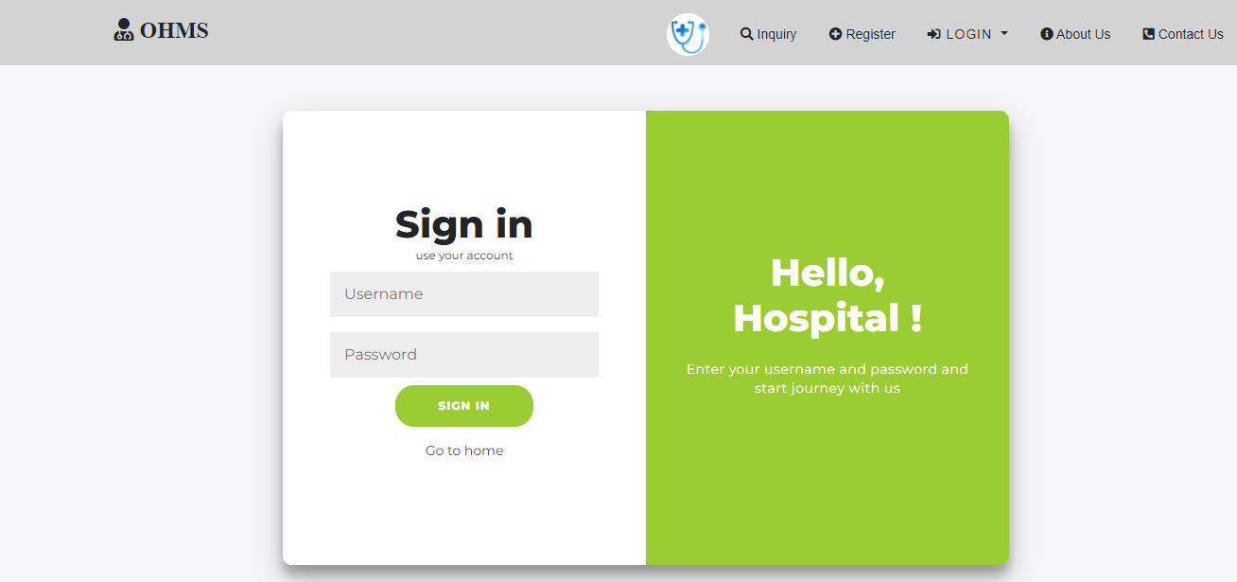
Hospital Login Page :-

Slide 31

Doctor Login Page :-

Slide 32
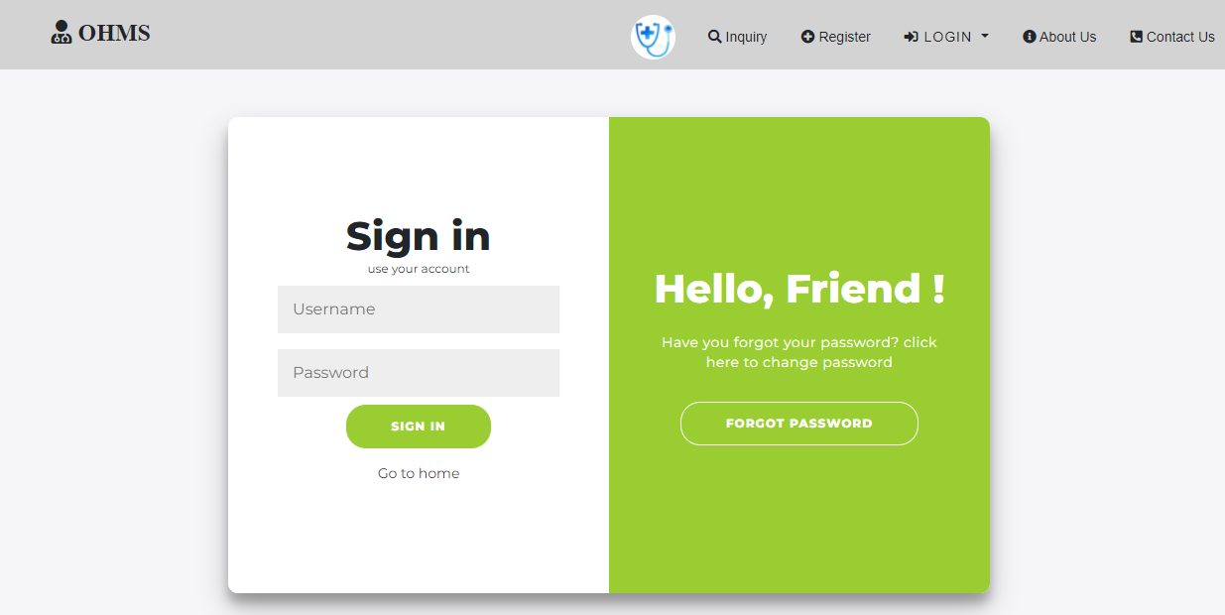
Patient Login Page :-

Slide 33
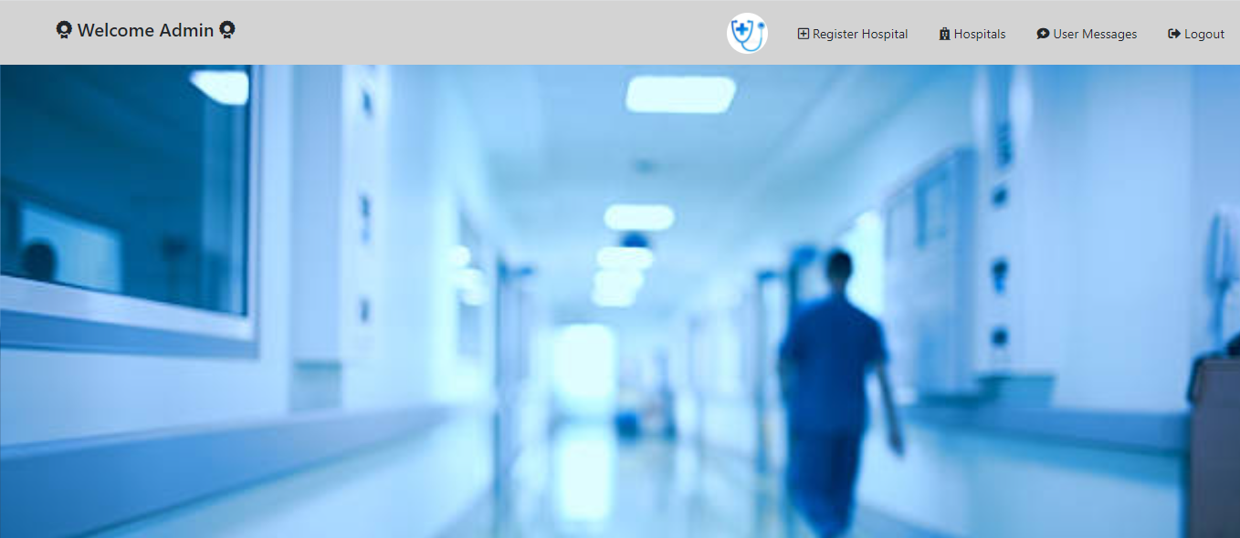
Admin Profile :-

Slide 34
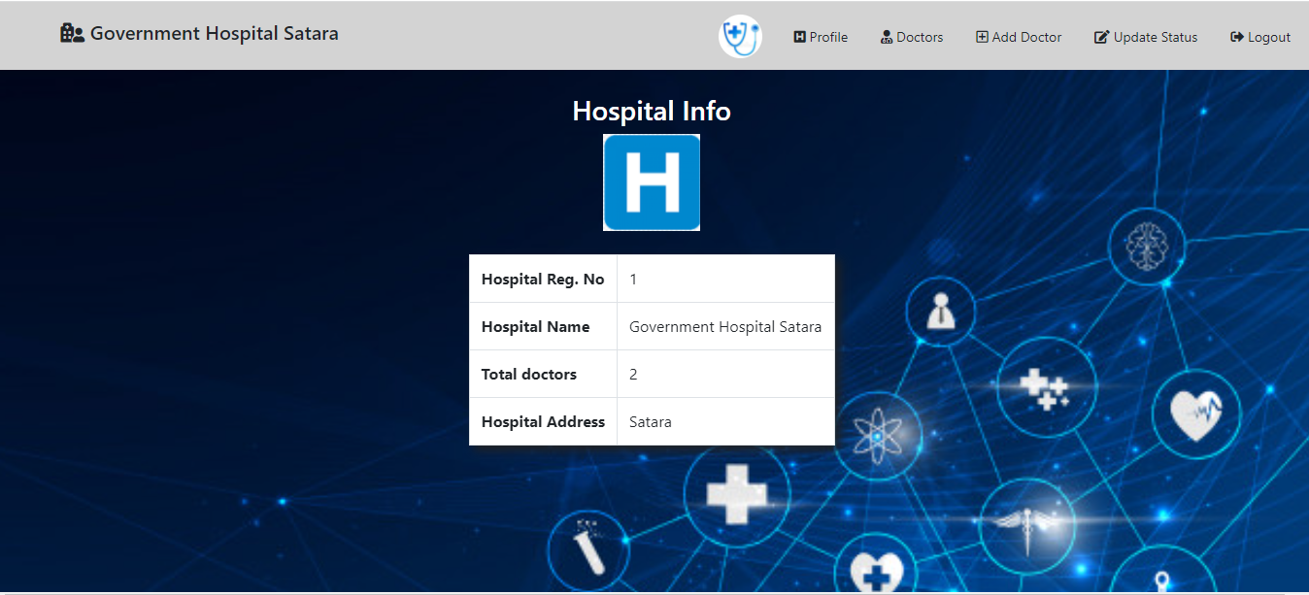
Registered Hospital Profile :-

Slide 35
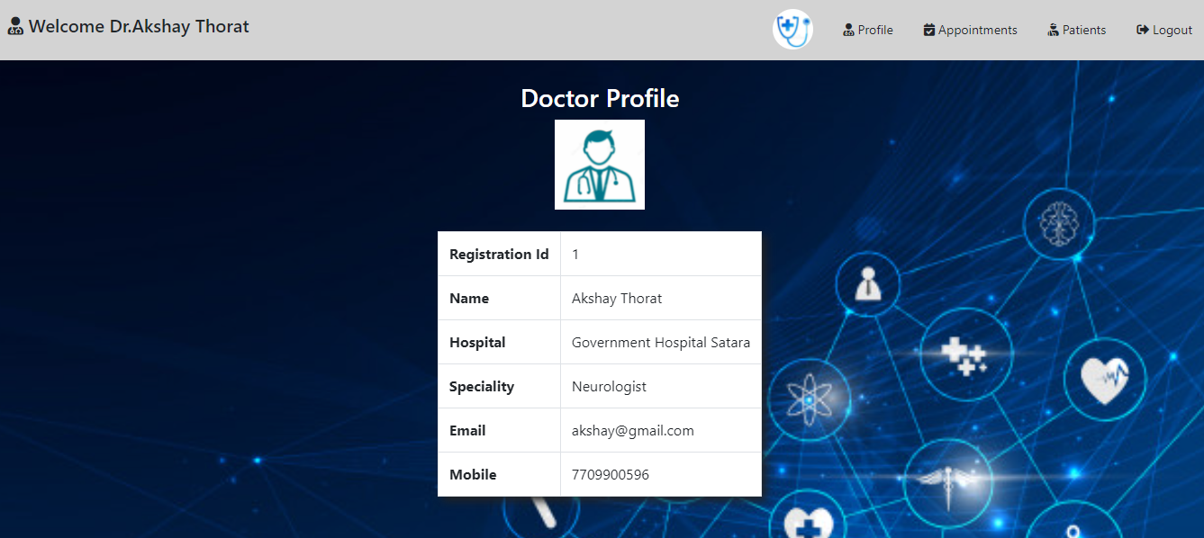
Registered Doctor Profile :-

Slide 36
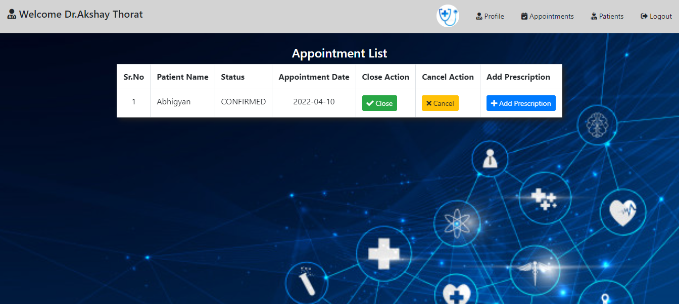
Appointment List :-

Slide 37
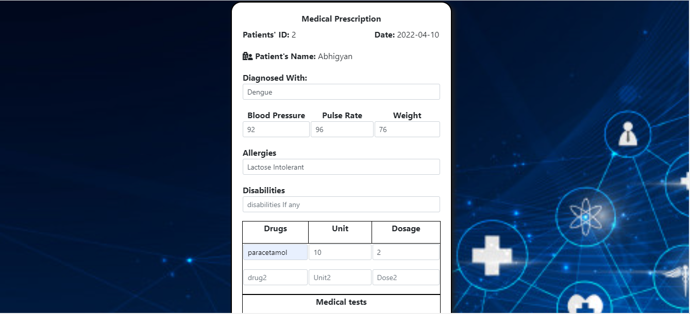
Prescription Form :-

Slide 38
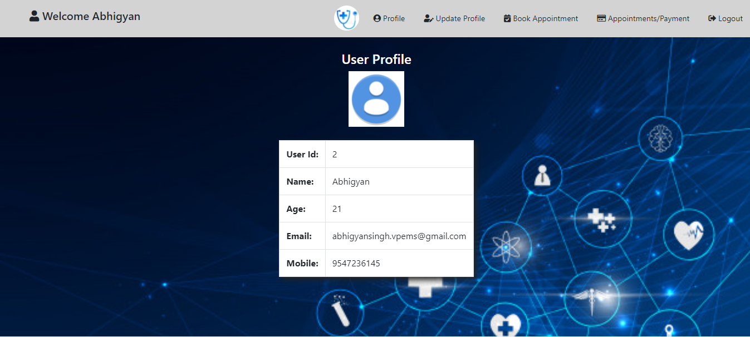
Registered Patient Profile :-

Slide 39
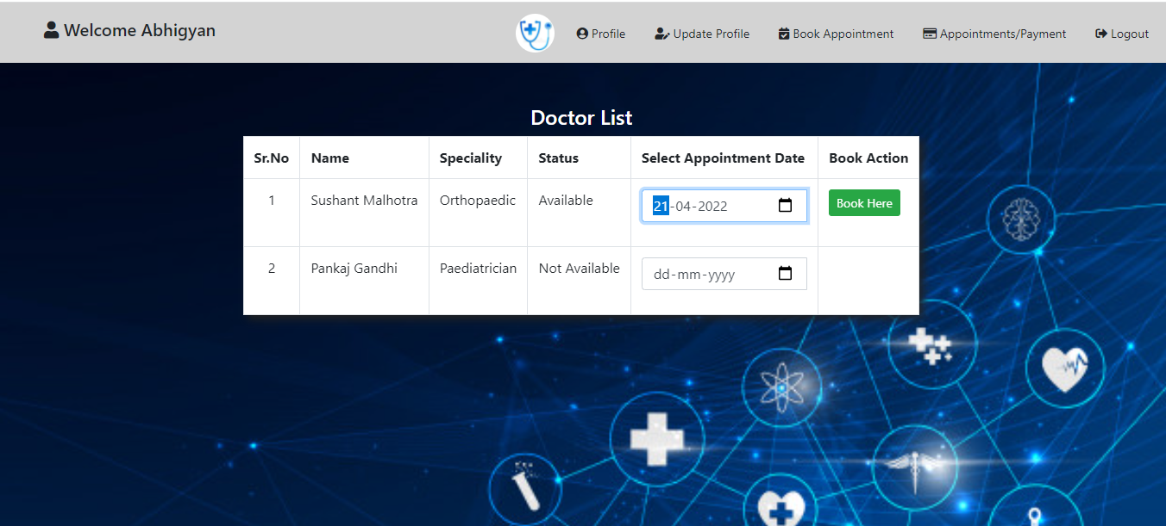
Available Doctors List:-

Slide 40
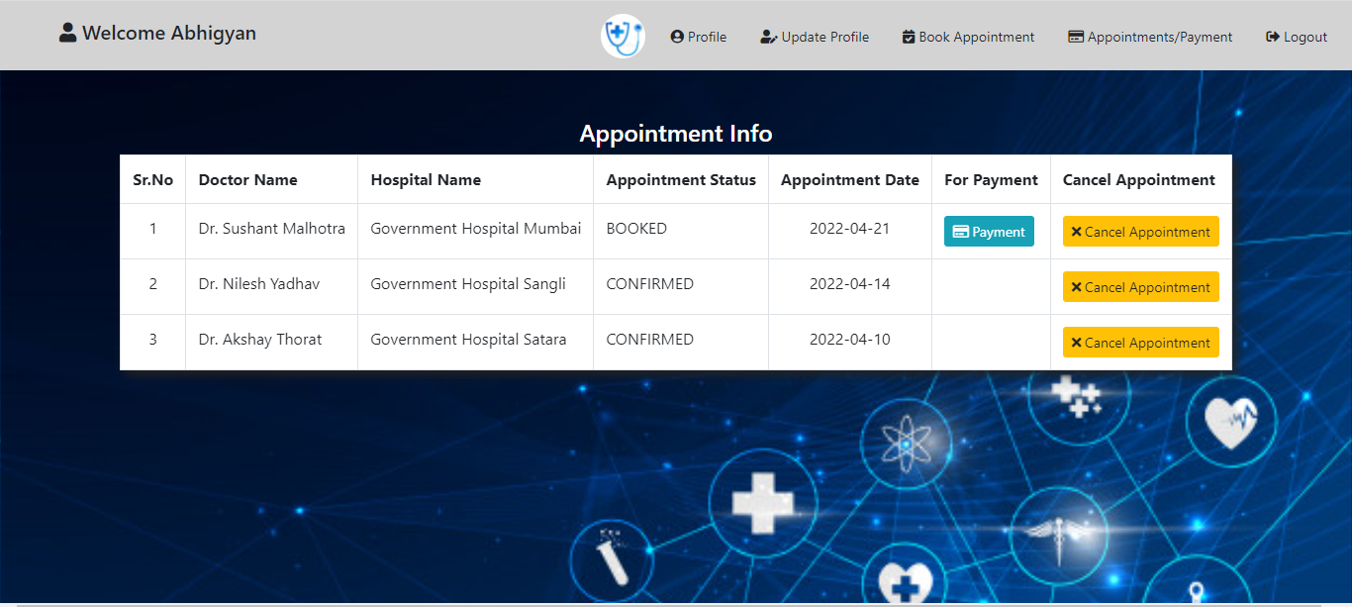
Payment Gateway :-

Slide 41
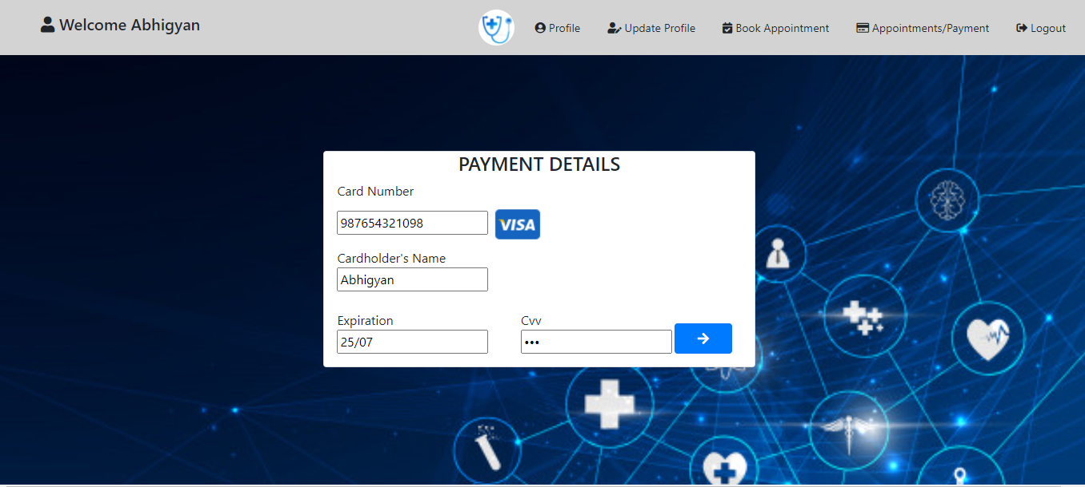

Slide 42
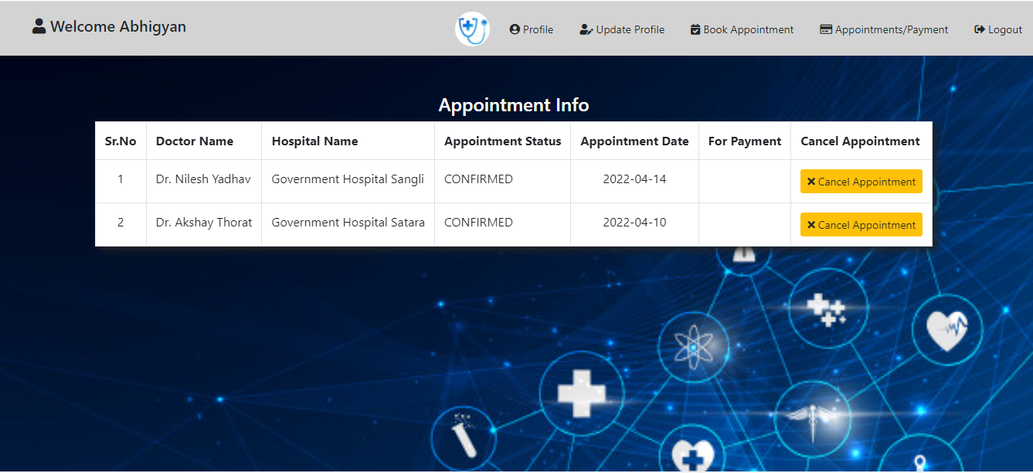
Booked Appointment List

Slide 43

About Us Page :-

Slide 44
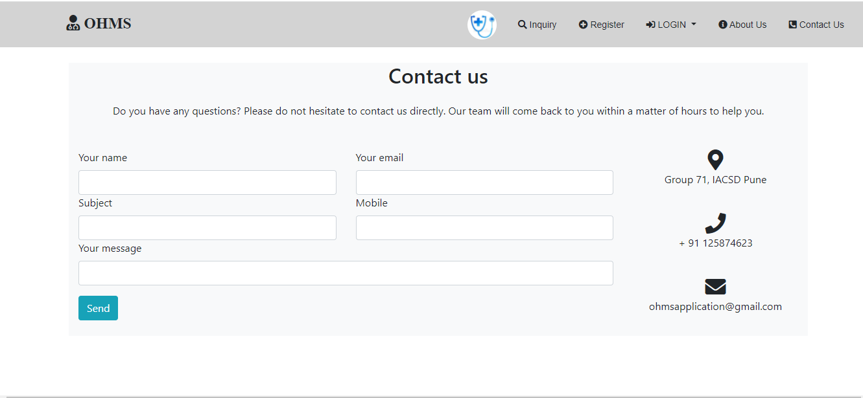
Contact Us Page :-

Slide 45
Thank You...

